Slide 1
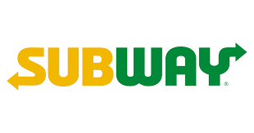
Subway sandwich online reservation system
Sevana Ahmadzada(20196348),
Zhansaya Satui(20180950),
Lim Zhan Yi(20196491)

Slide 2
Contents
Description of the project
Background information & project description
Interview & survey results
Project Definition (Objectives & Strategies)
Scenario
Process Models (Swim-lane charts)
Data Flow Diagram (DFD), ERD, Relationship diagrams
Table Definition
UI Development
Table(MySQL)
SQL statement

Slide 3
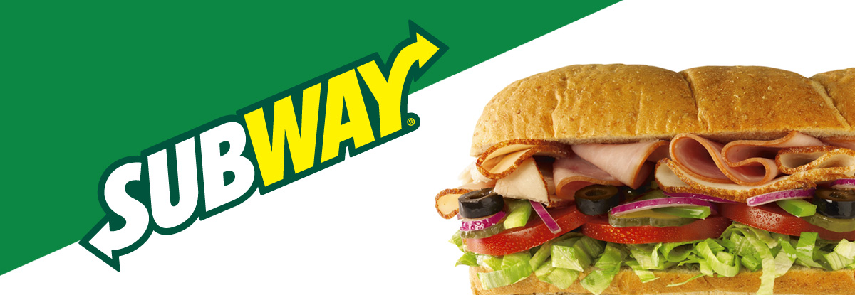
About Subway
Subway is an American privately-held restaurant franchise that primarily sells submarine sandwiches (subs) and salads. It is one of the fastest-growing franchises in the world and, as of October 2019, had 41,512 locations in more than 100 countries. More than half its locations (23,928 or 57.6%) are in the United States. It also is the largest single-brand restaurant chain, and the largest restaurant operator, in the world.

Slide 4
Description of the Project
Online order
People are able to choose their own ingredients
Delivery to specific location
VIP customers(for period)
Leaving comments on website/Review
Manages supplier system(controlling products expiration date)

Slide 5
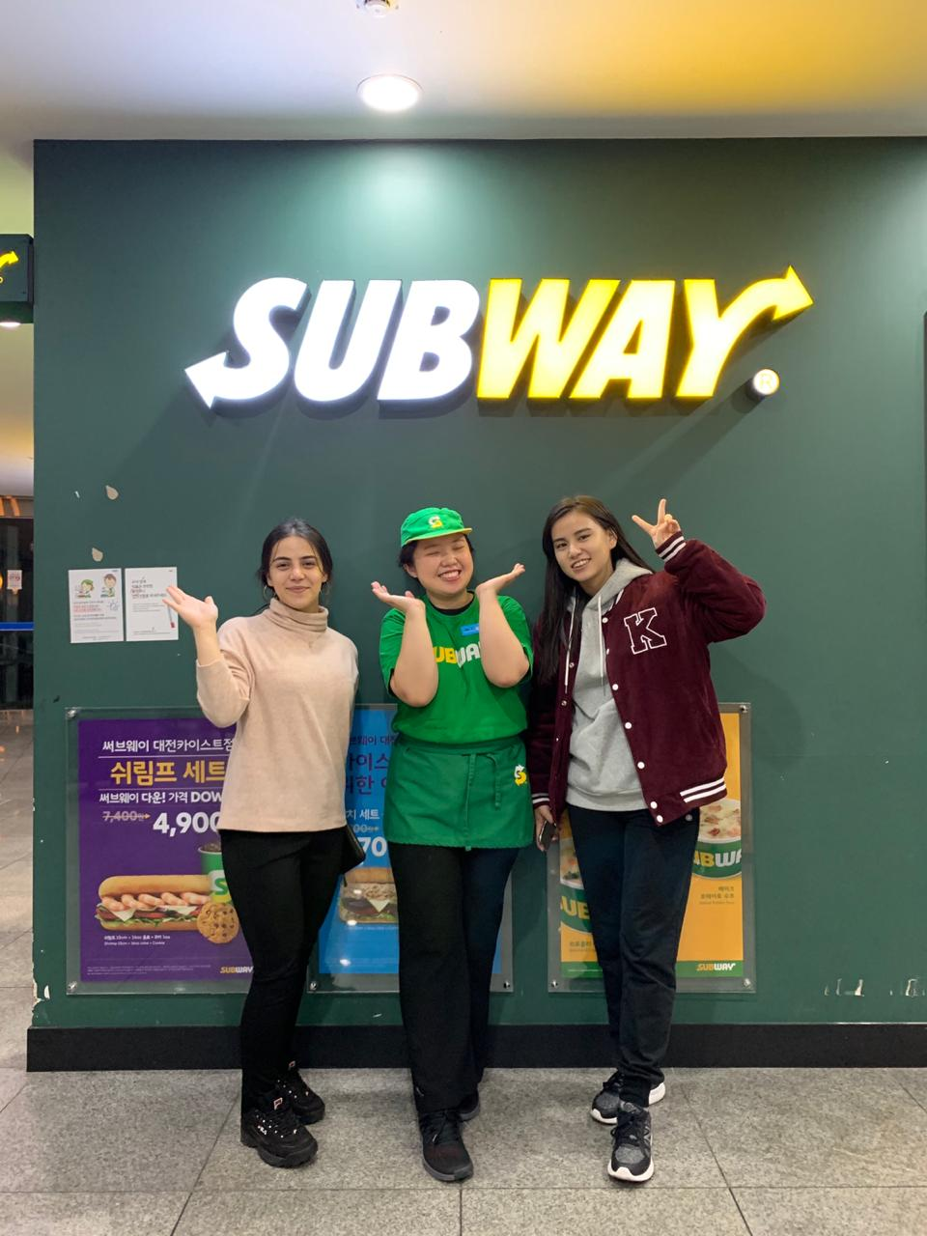
Survey & Interview
Information collection:
Reference sites: SUBWAY official website (https://www.subway.com/en-US)
Interview with outlet employee
Customer survey
Current problems for employee:
1) What is your opinion about current system?
1) What do you think about implementing an online ordering system?
3) What are the problems most frequently faced in your store?
Customer survey:
1)Have you ever had a problem with delivery company(person)?
2)How satisfied are you(from 1 to 5) with current order and delivery price?
3) How satisfied are you(from 1 to 5) with delivery time?

Slide 6
Current problems from the viewpoint of workers
product is stolen during delivery time(no identification)
People don’t want to pay for delivery that much as compared to current system
May be inefficient for workers to handle orders from multiple platforms simultaneously(online and physical)
Can be complicated to work with several delivery companies

Slide 7
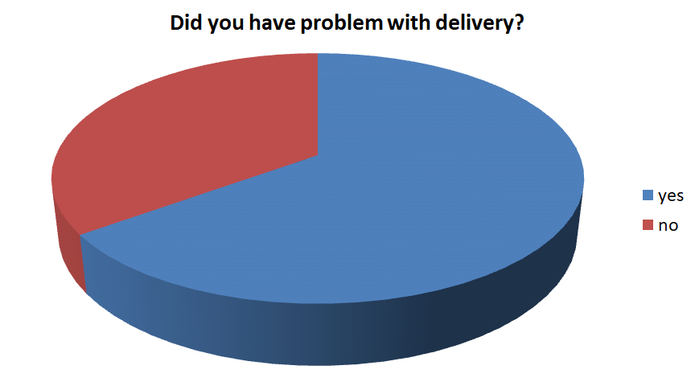

Slide 8
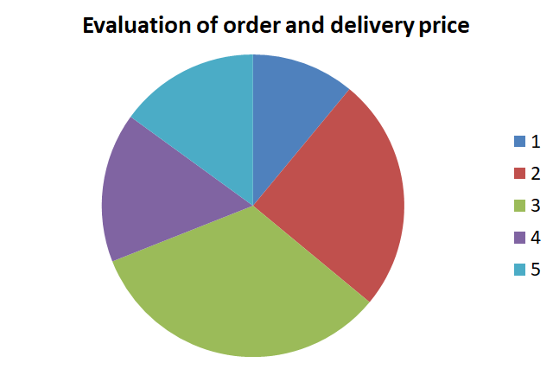
Survey results

Slide 9
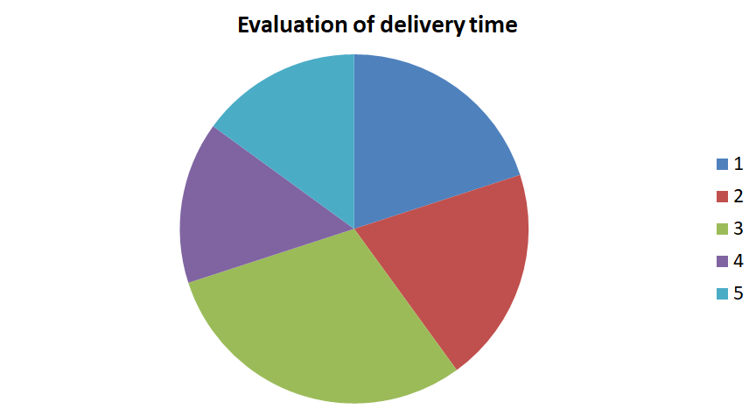

Slide 10
The problems mentioned by customers
Did not receive order (Food was stolen?)
Order was wrong
Hard to find delivery person
Delivery price is too high

Slide 11
Project Definition
Objectives: Optimize the current system by digitalizing the ordering
Target members: Clients of Subway sandwich store
Strategies:
Create the web page for Subway system to simplify the ordering
Easy and fast working system
Hypothesis: more clients; saved time;

Slide 12
Typical use-case scenarios:
User opens homepage of Subway system to order -> login/signup -> choose the product materials and confirm order -> payment process -> order completed
Material Supplier relationship: System will notify admin if the material amount is below critical quantity so that company can contact specific suppliers with the help of the system.
Shop finding: Customer will click a button to automatically obtain latitude & longitude coordinates by our program, which will also calculate the distance to determine the nearest shop from the customer.

Slide 13
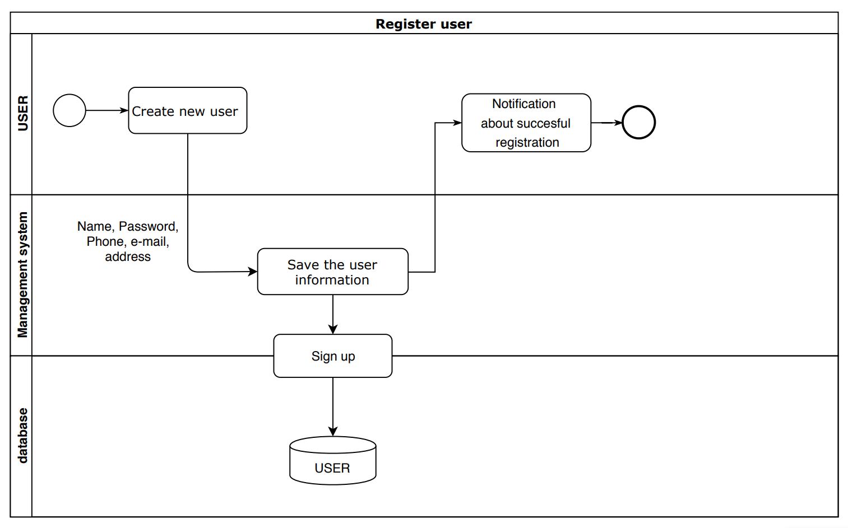
Register user Swim-lane Chart

Slide 14
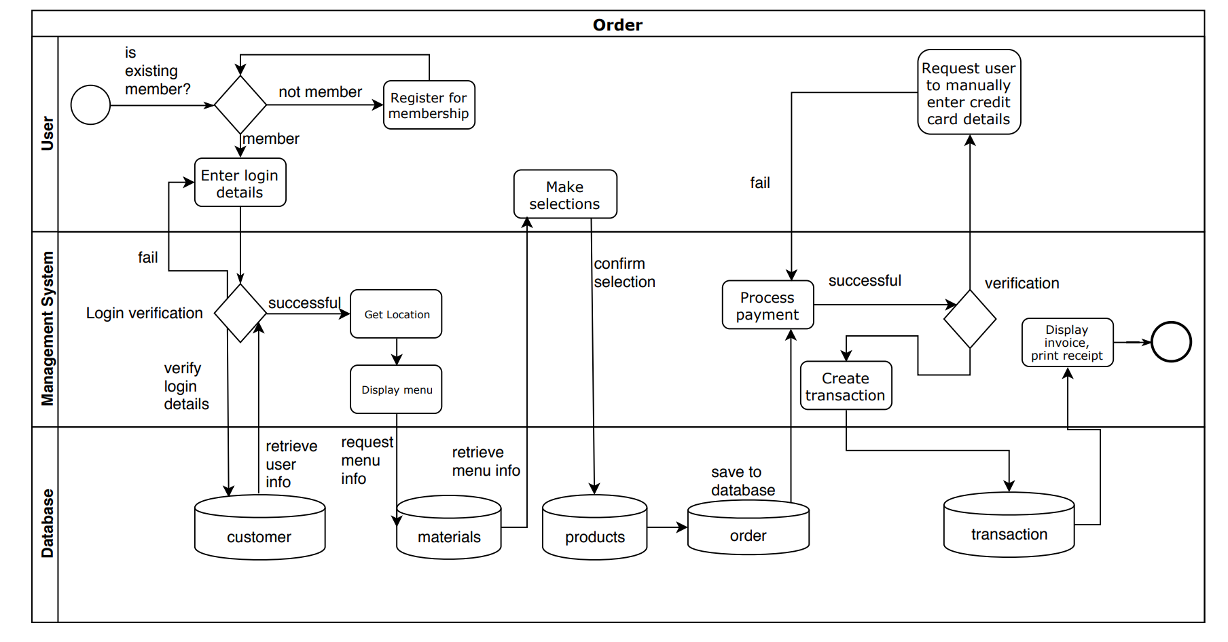
Order Swim-Lane Chart

Slide 15
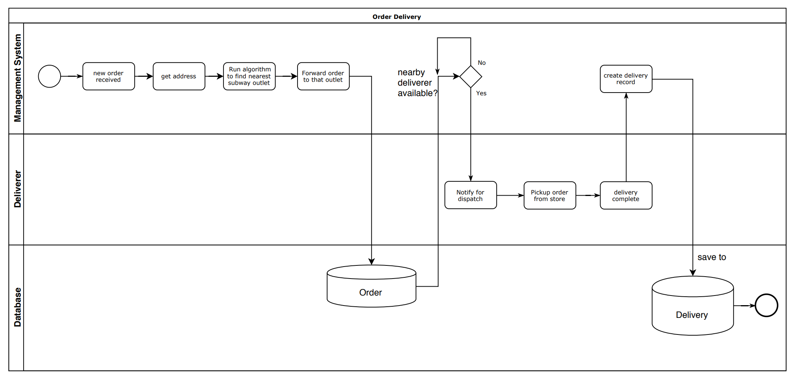
Order Delivery Swim-lane chart

Slide 16
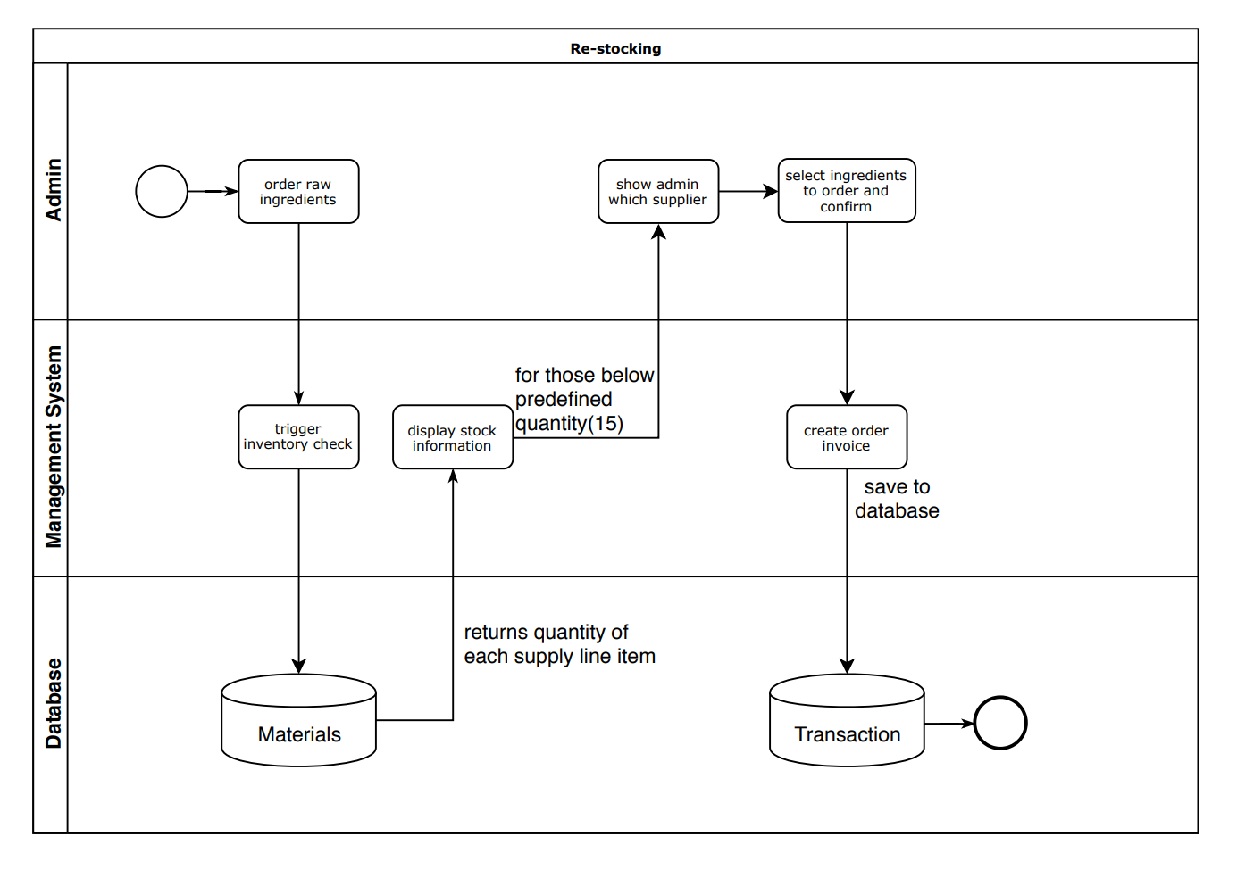
Re-stocking Swim-lane chart

Slide 17
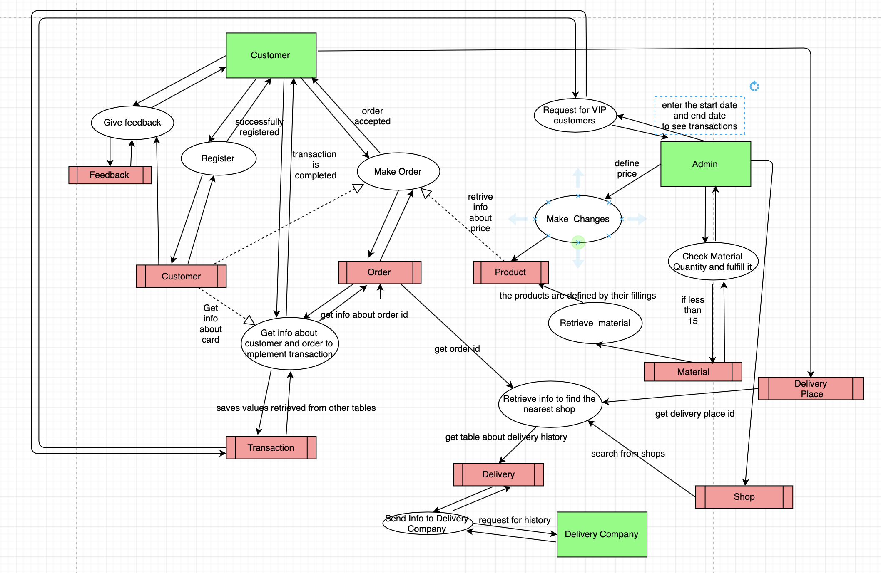
Process & Data Model (DFD)
Notes:
Vip customer from transaction

Slide 18
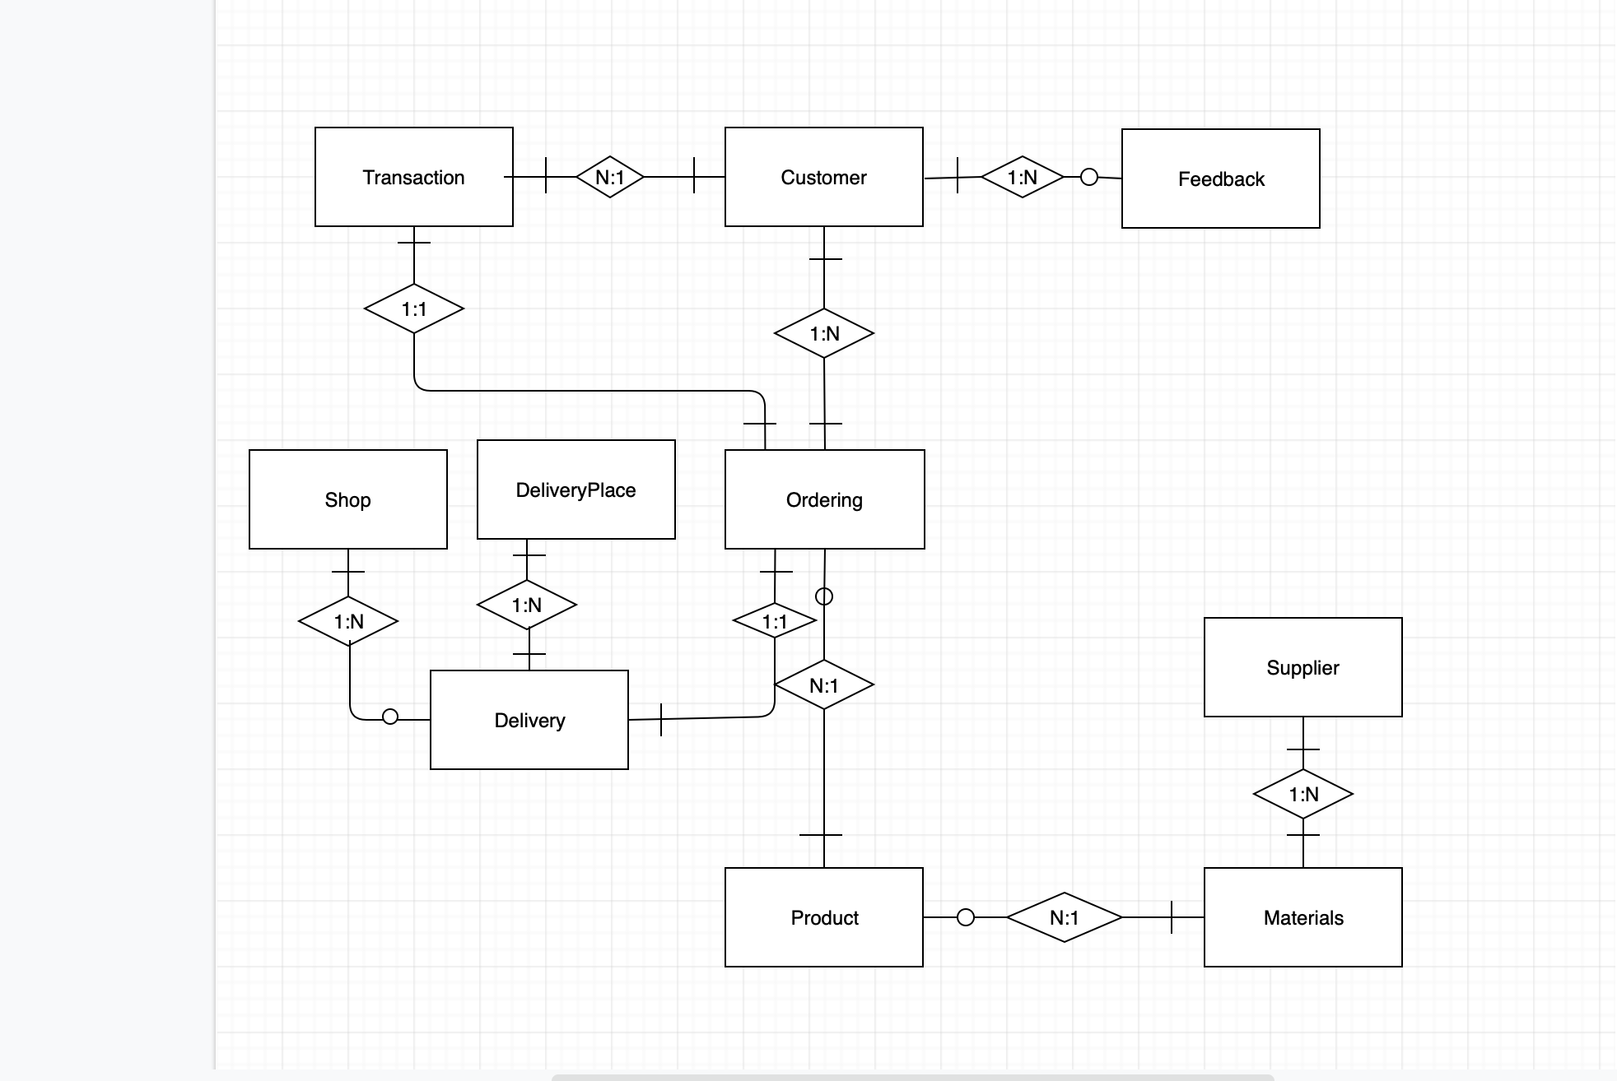
Entity Relationship Diagram (ERD)

Slide 19
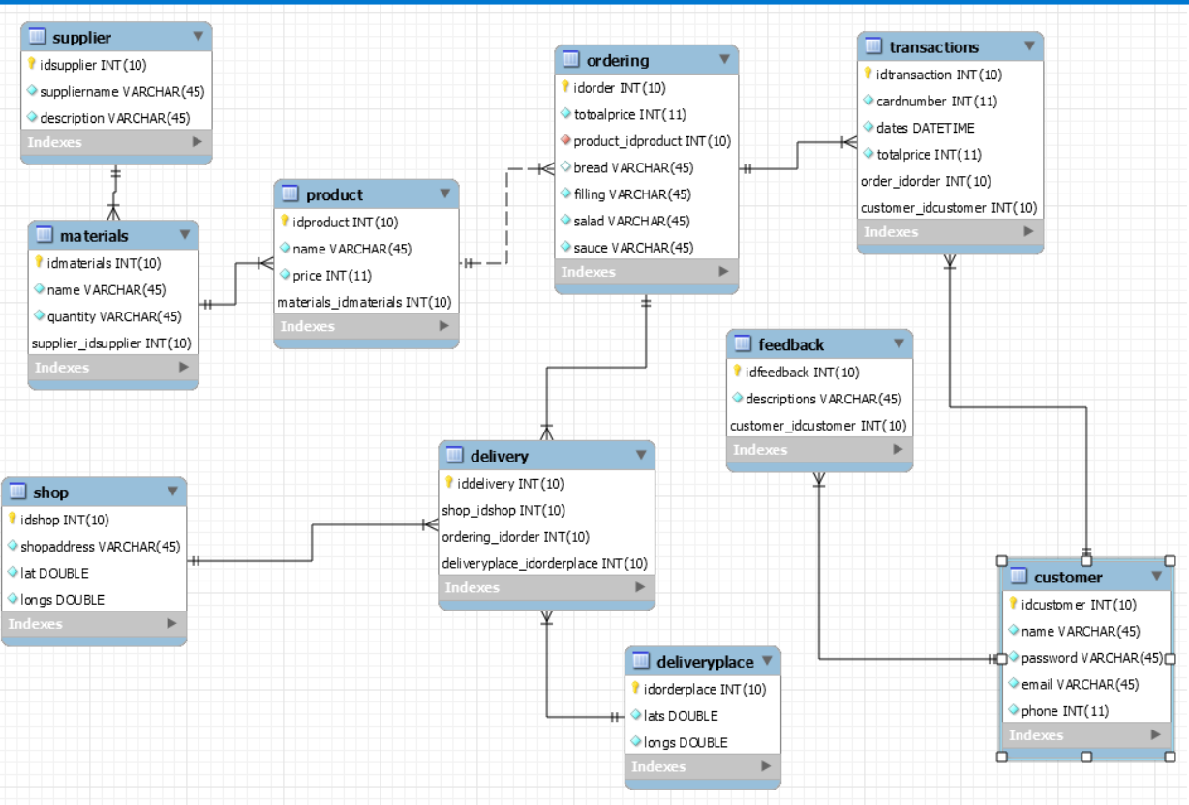
Relationship chart

Slide 20
Table definitions
Customer(idcustomer, name, password, email, phone)
Shop(idshop, shopaddress, lat, longs )
Materials(idmaterials, name, quantity, supplierID)
Product(idproduct, name, price, materialsID)
Ordering(idorder, productID, totalprice, bread, filling, salad, sauce) (price of sandwich depends on meat type, that is the range of values in productID)
Transactions(idtransaction, cardnumber, dates, totalprice, orderID, customerID)
Supplier(idsupplier, suppliername, description)
Delivery(iddelivery, shopID, orderingID, deliveryplaceID)
Feedback(idfeedback, descriptions, customerID)
DeliveryPlace(idorderplace, lat, longs)

Slide 21
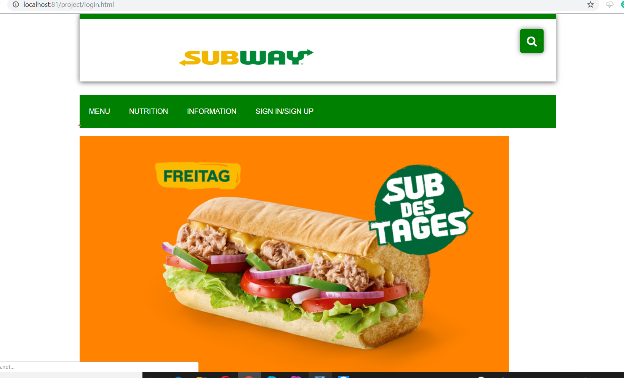
System UI: Main Page

Slide 22
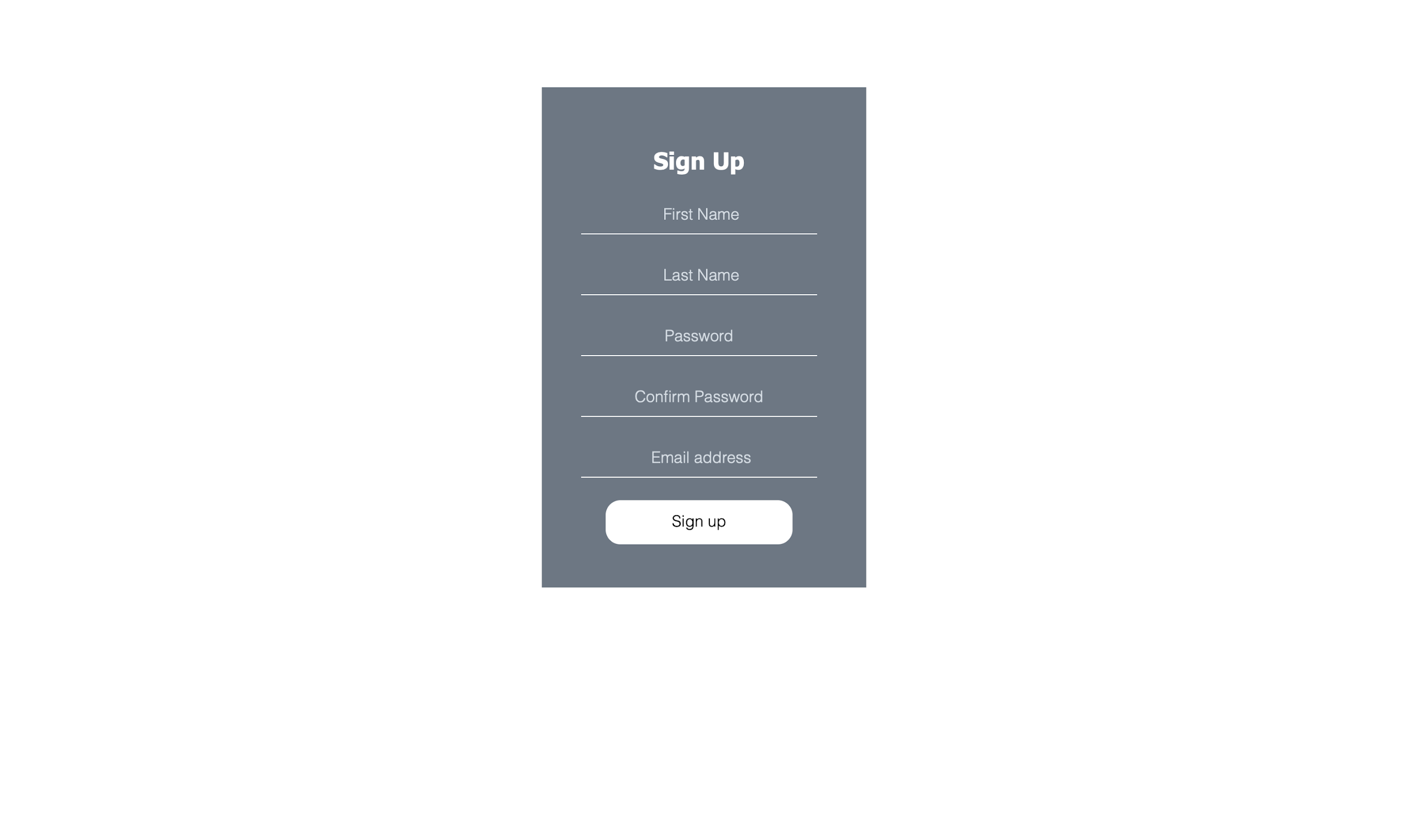
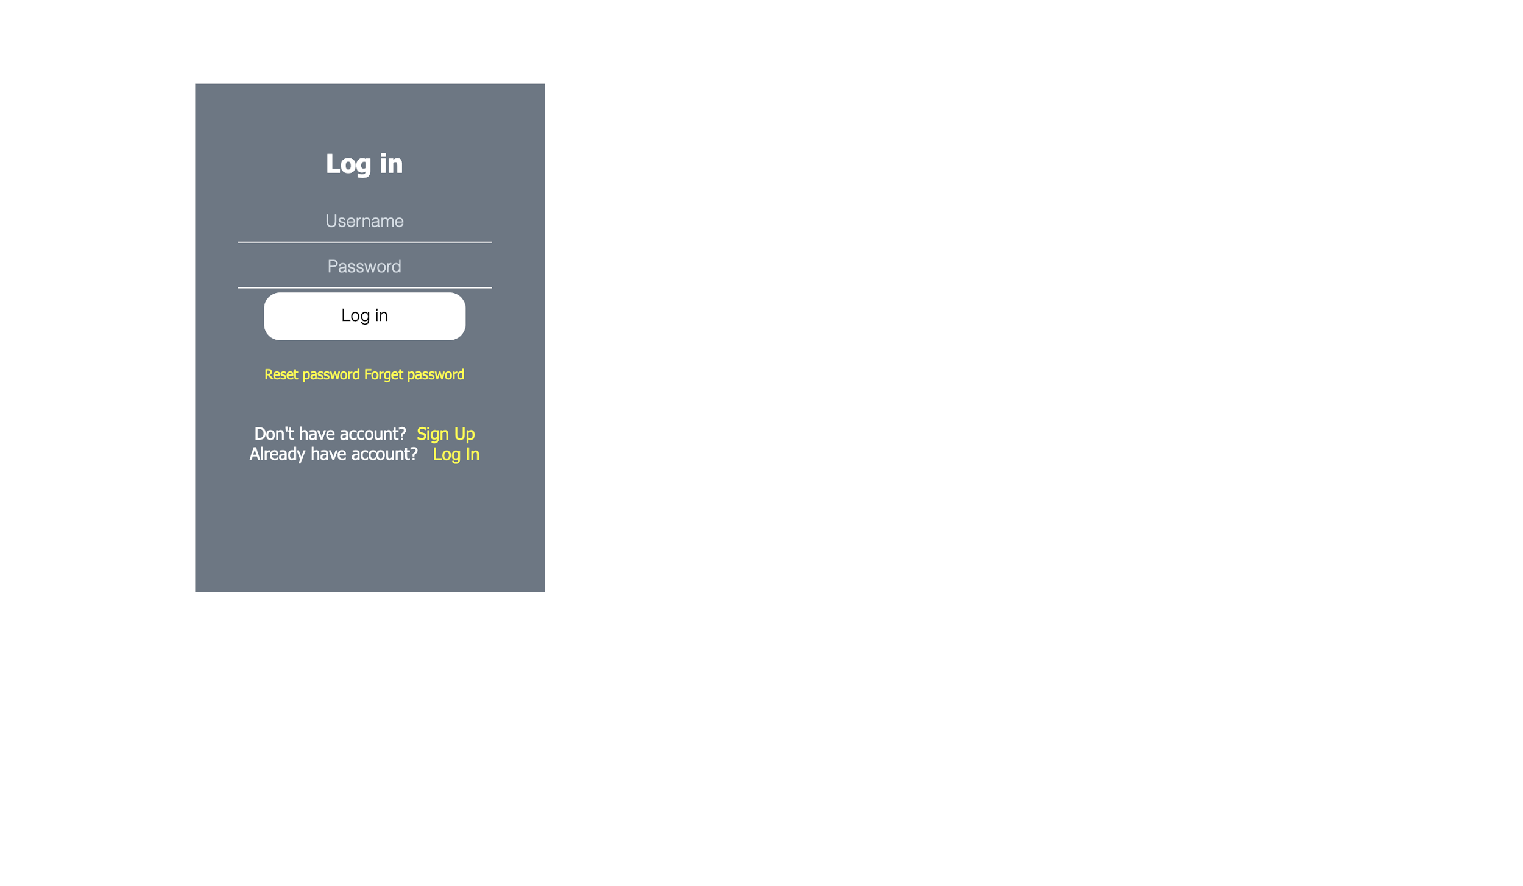
System UI: Registration

Slide 23
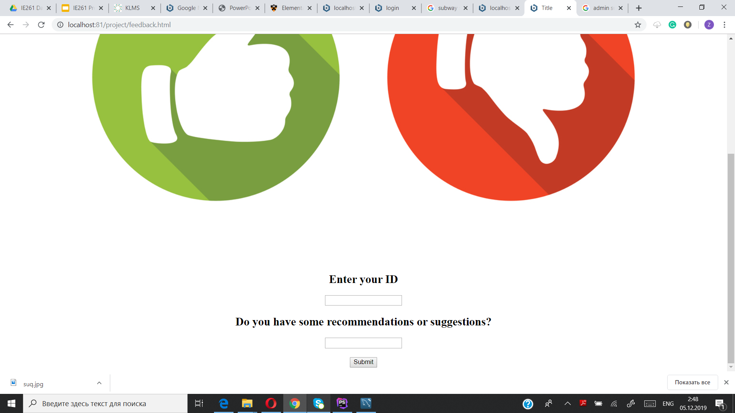
Feedback From Customers

Slide 24
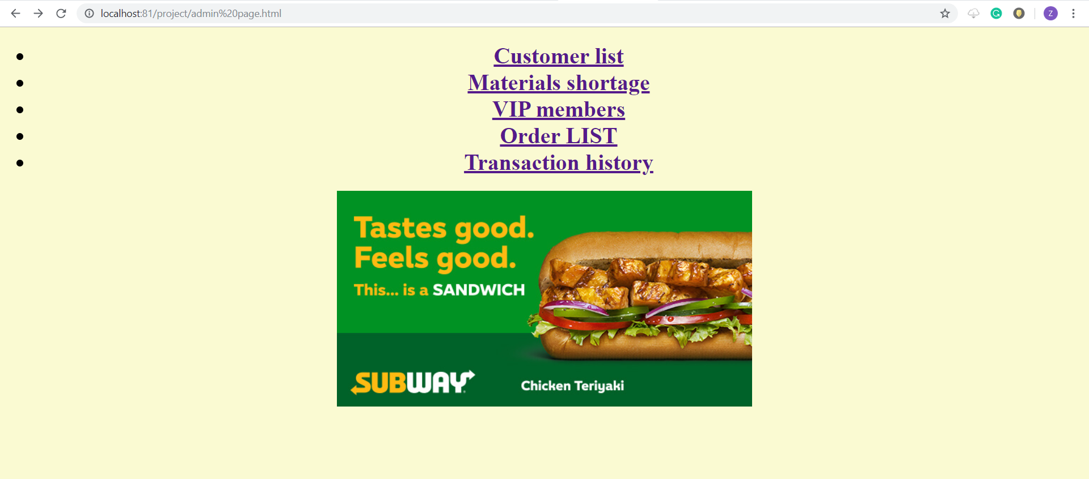
Admin Page

Slide 25
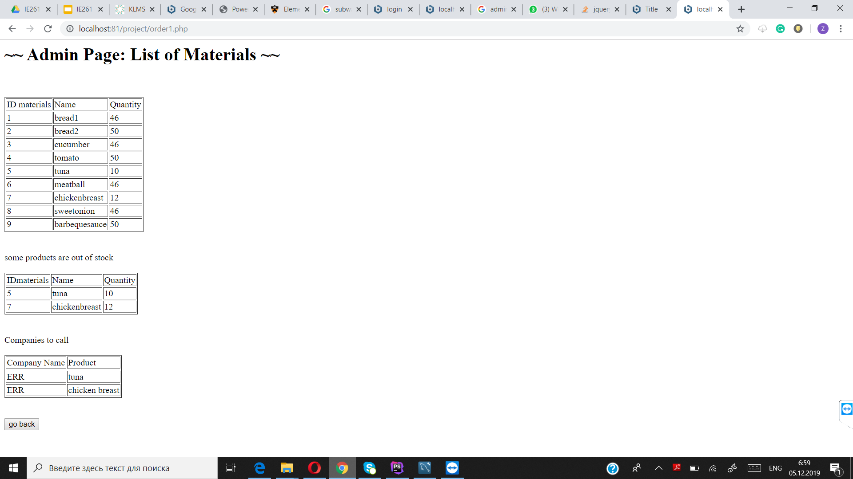
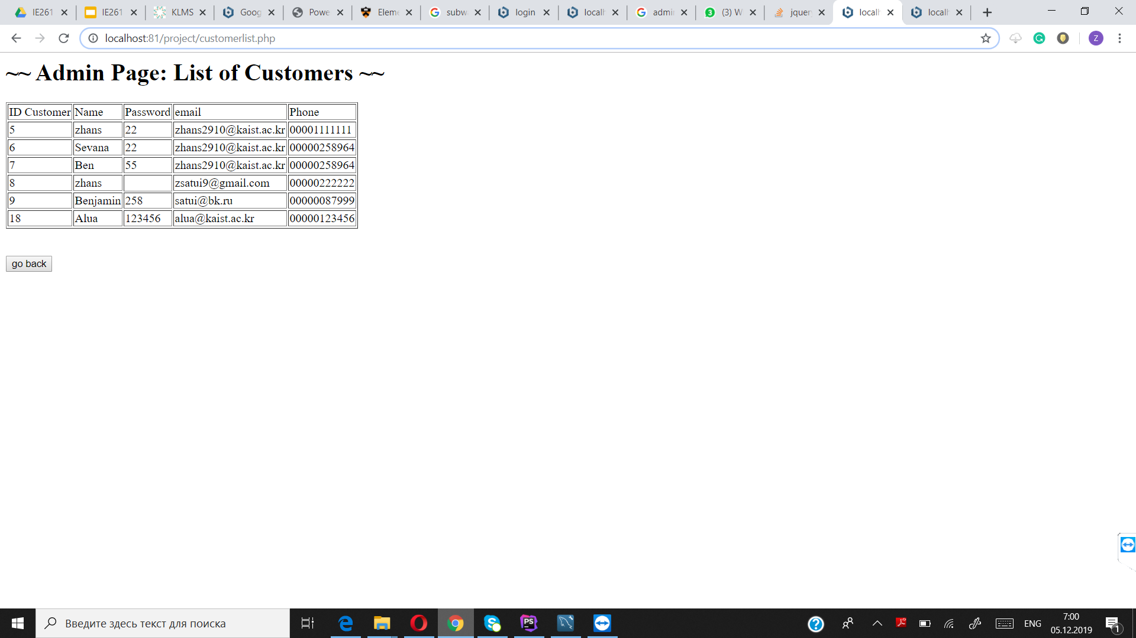

Slide 26
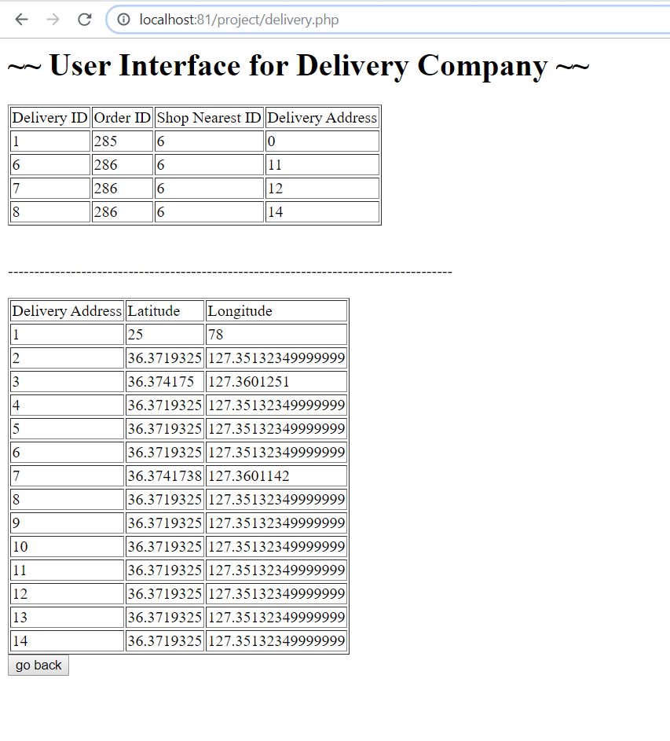
Delivery Company UI

Slide 27
Workbench MySQL
$sql1="update materials set quantity=quantity-1 where idmaterials in ('$nbread','$nfilling','$nsalad','$nsauce')";
$sql="select * from ordering";
$sql_zad="select price from product where idproduct=$nfilling-4";
$res_zad=$conn->query($sql_zad);
$row3=$res_zad->fetch_assoc();
$row33=$row3['price'];
$sql_zada="select idproduct from product where idproduct=$nfilling-4";
$res_zada=$conn->query($sql_zada);
$row4=$res_zada->fetch_assoc();
$row44=$row4['idproduct'];
$sql_order="insert into ordering (totoalprice, product_idproduct, bread, filling, salad, sauce) values ('$row33','$row44','$nbread','$nfilling','$nsalad', $nsauce) on duplicate key update idorder=idorder+1";
$res_u=$conn->query($sql);

Slide 28
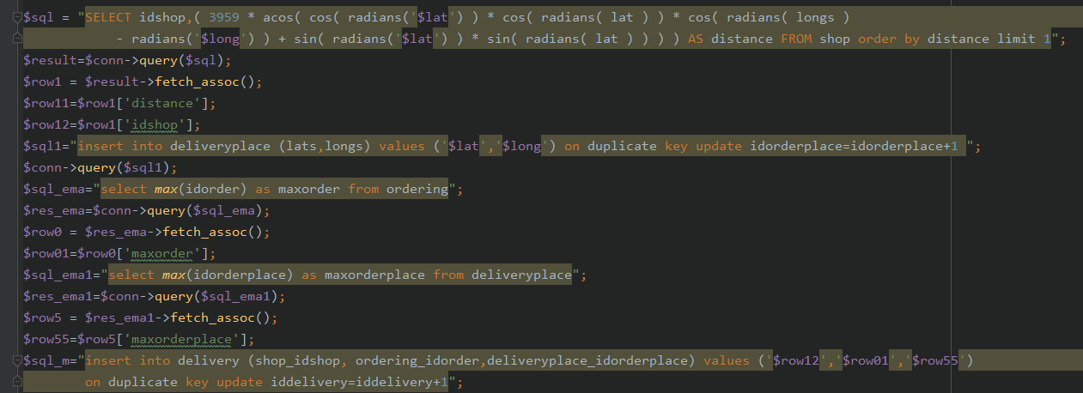
Finding the nearest shop to the given location

Slide 29
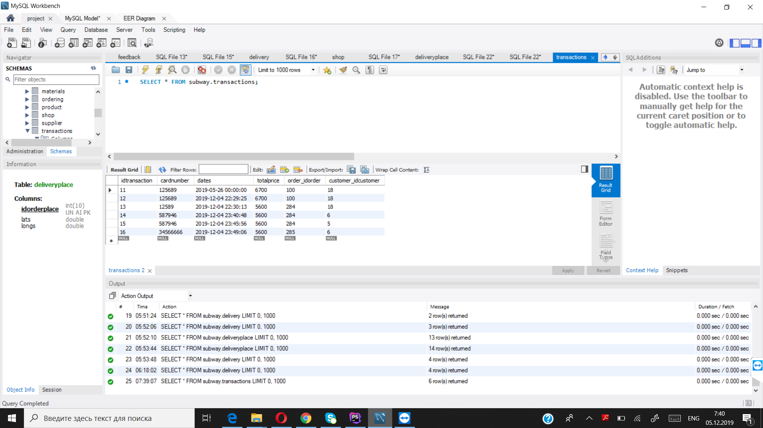
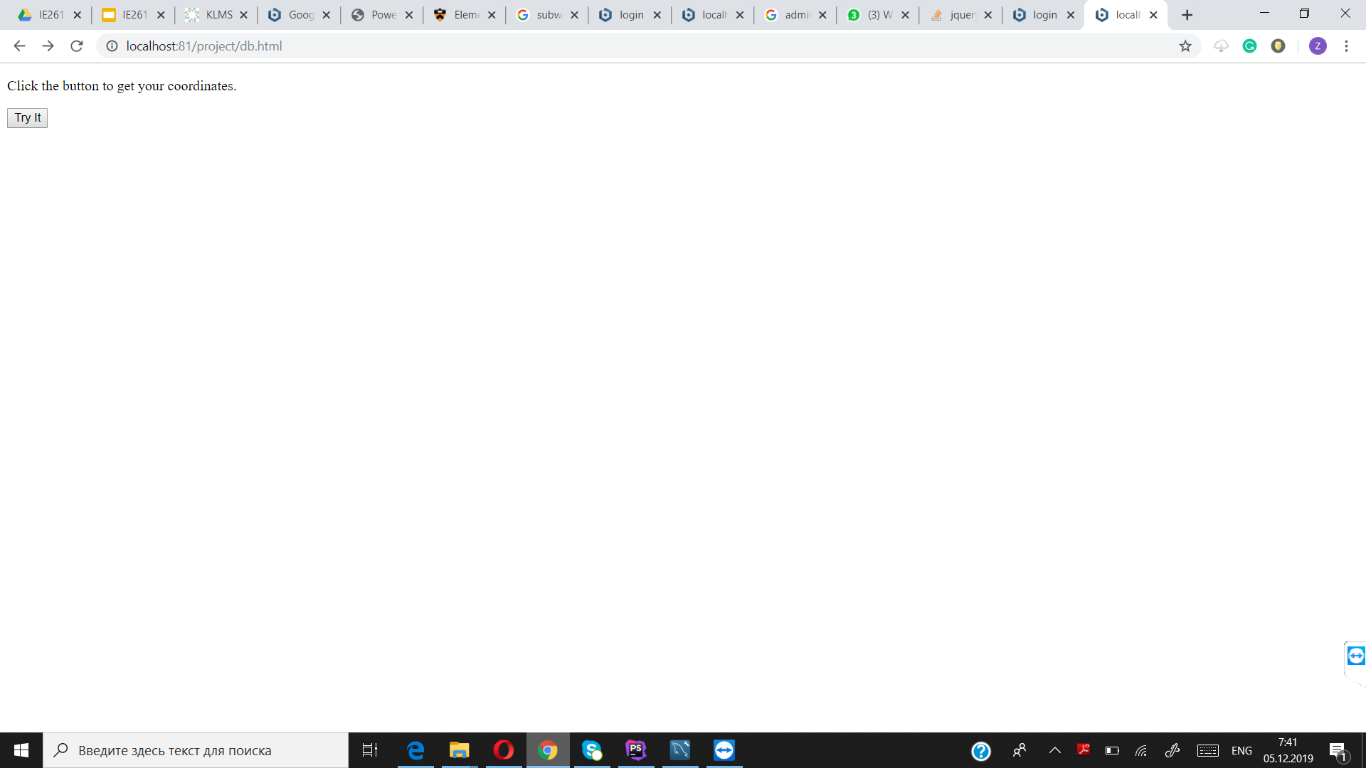
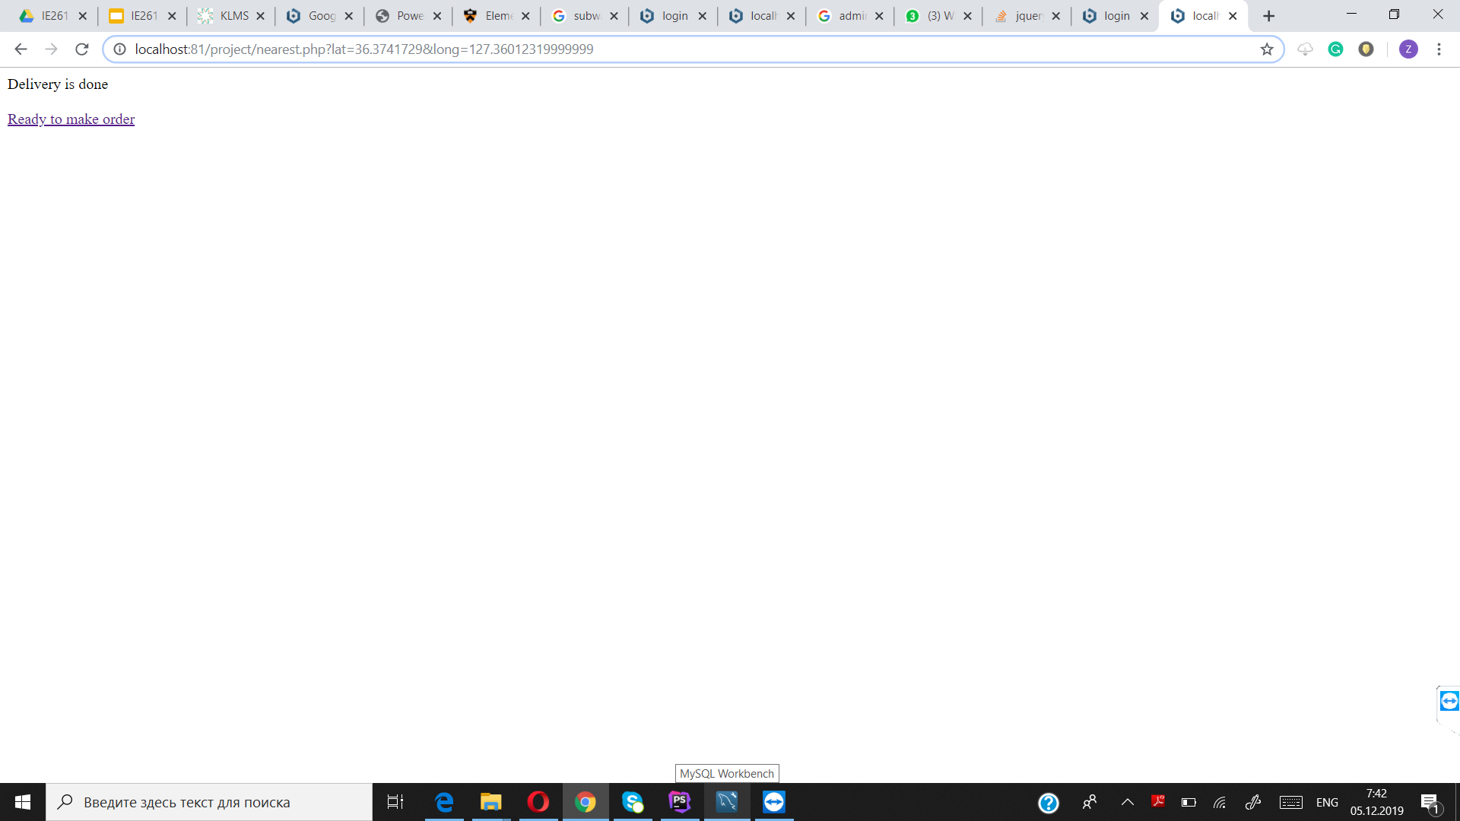
Table (MySQL)
Transaction info table
Finding the location and the nearest shop

Slide 30
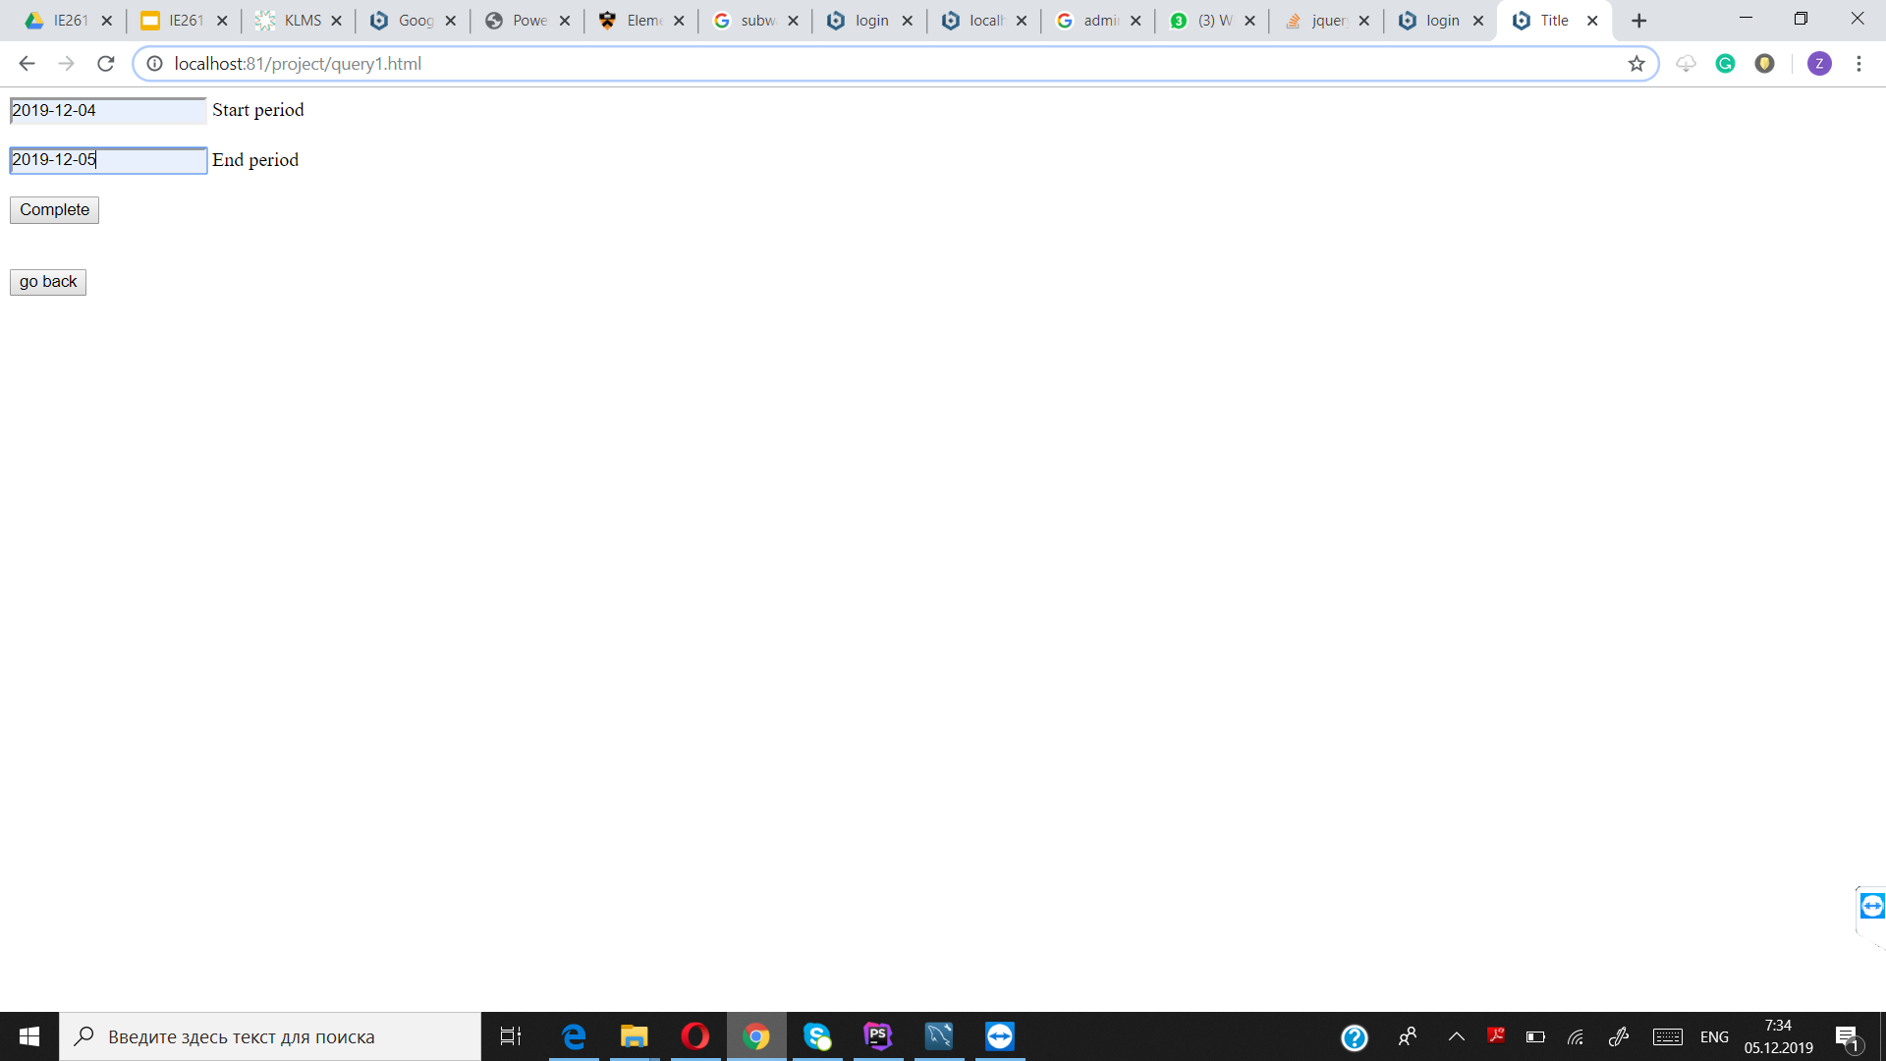
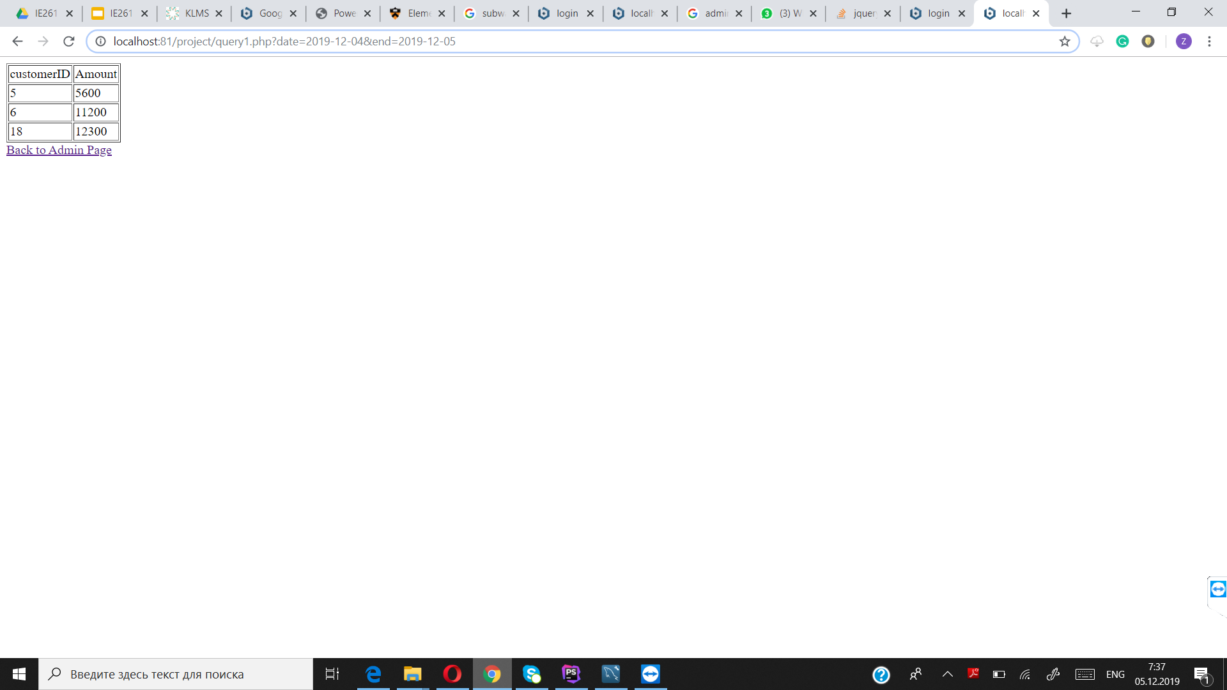

Table (MySQL) VIP customers

Slide 31
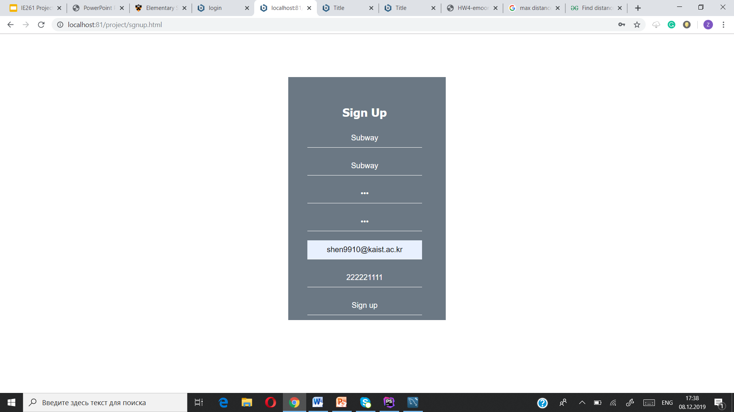
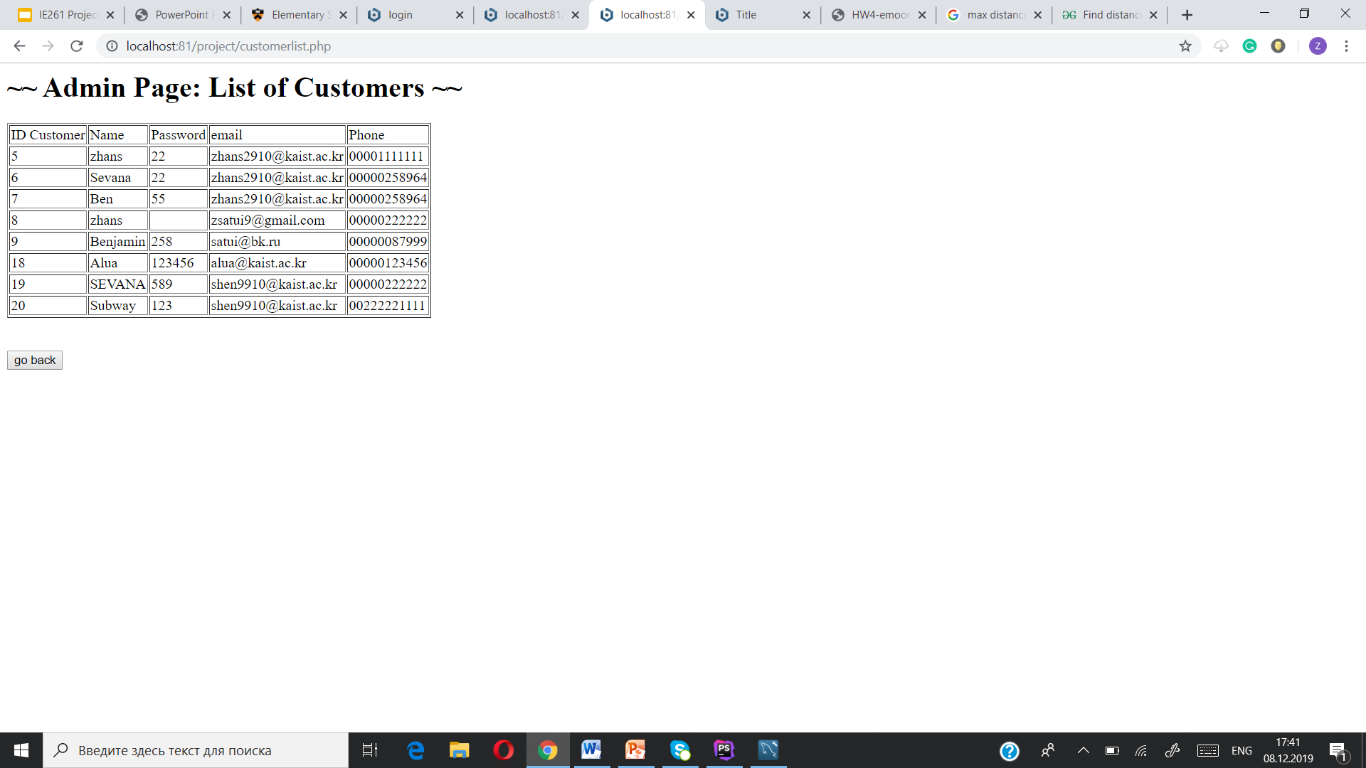
Explaining each step: Sign Up

Slide 32
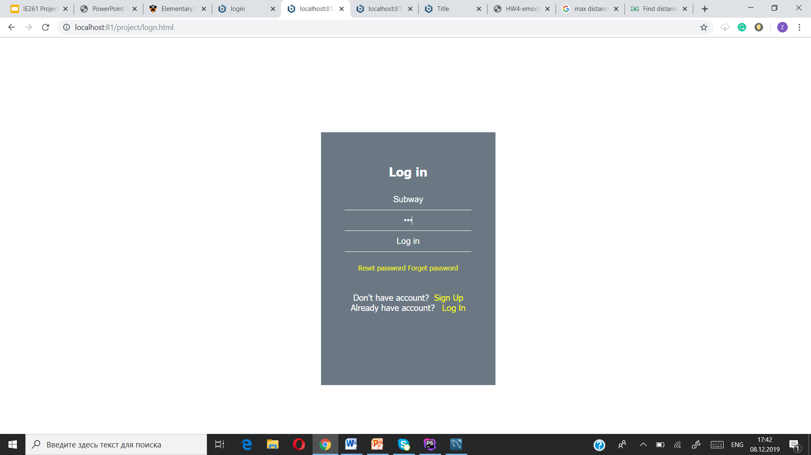
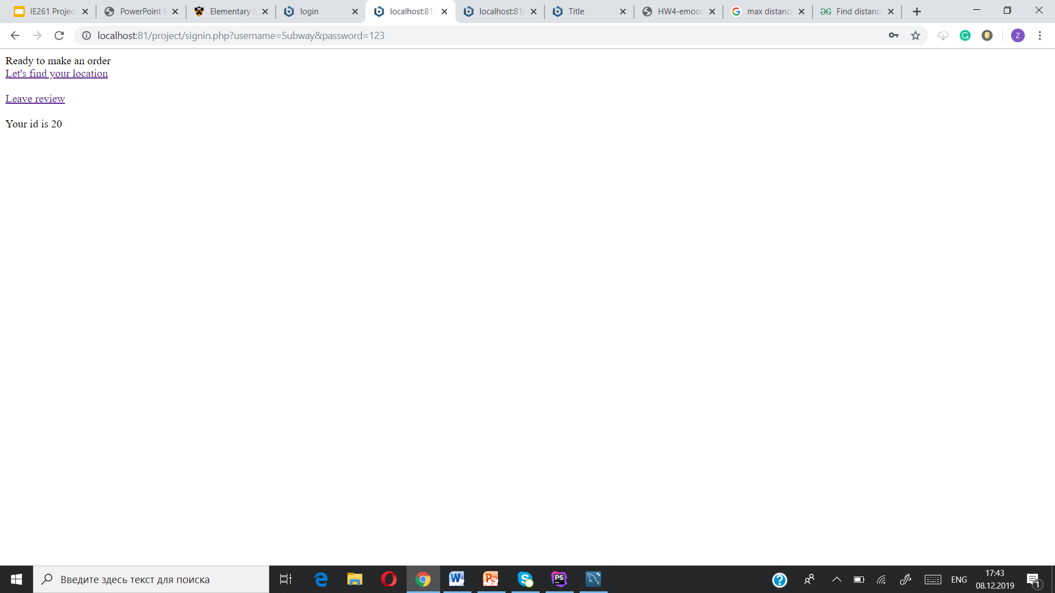
Log in and make order

Slide 33
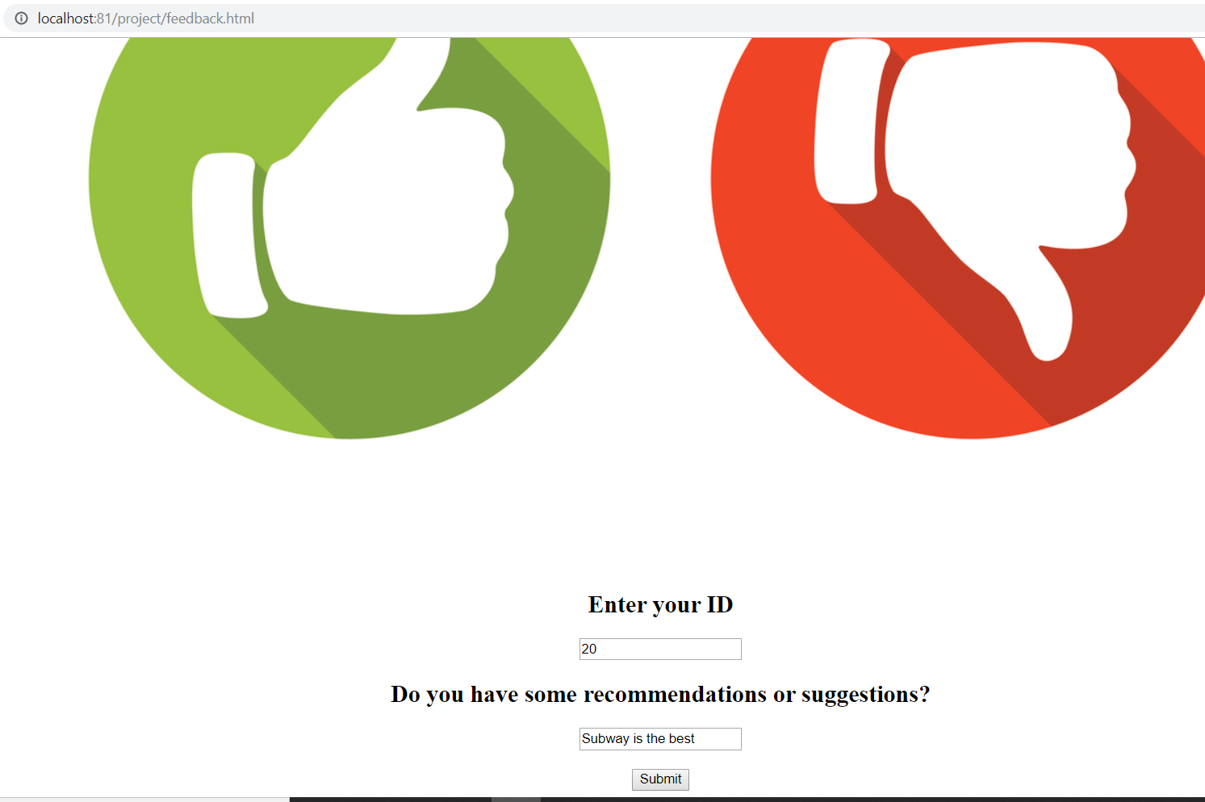
Leave feedback

Slide 34
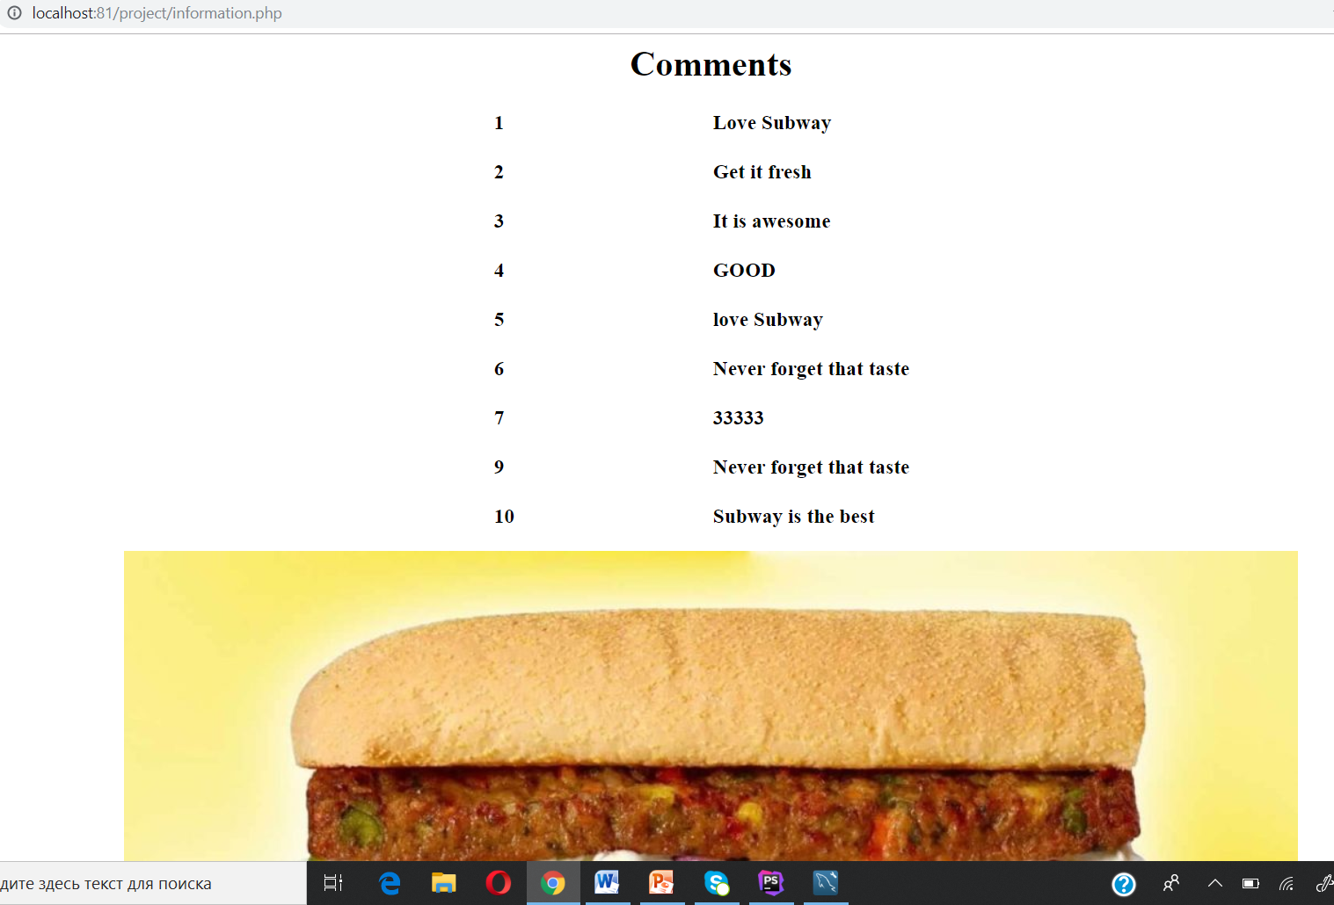
Added feedback is on the interface

Slide 35
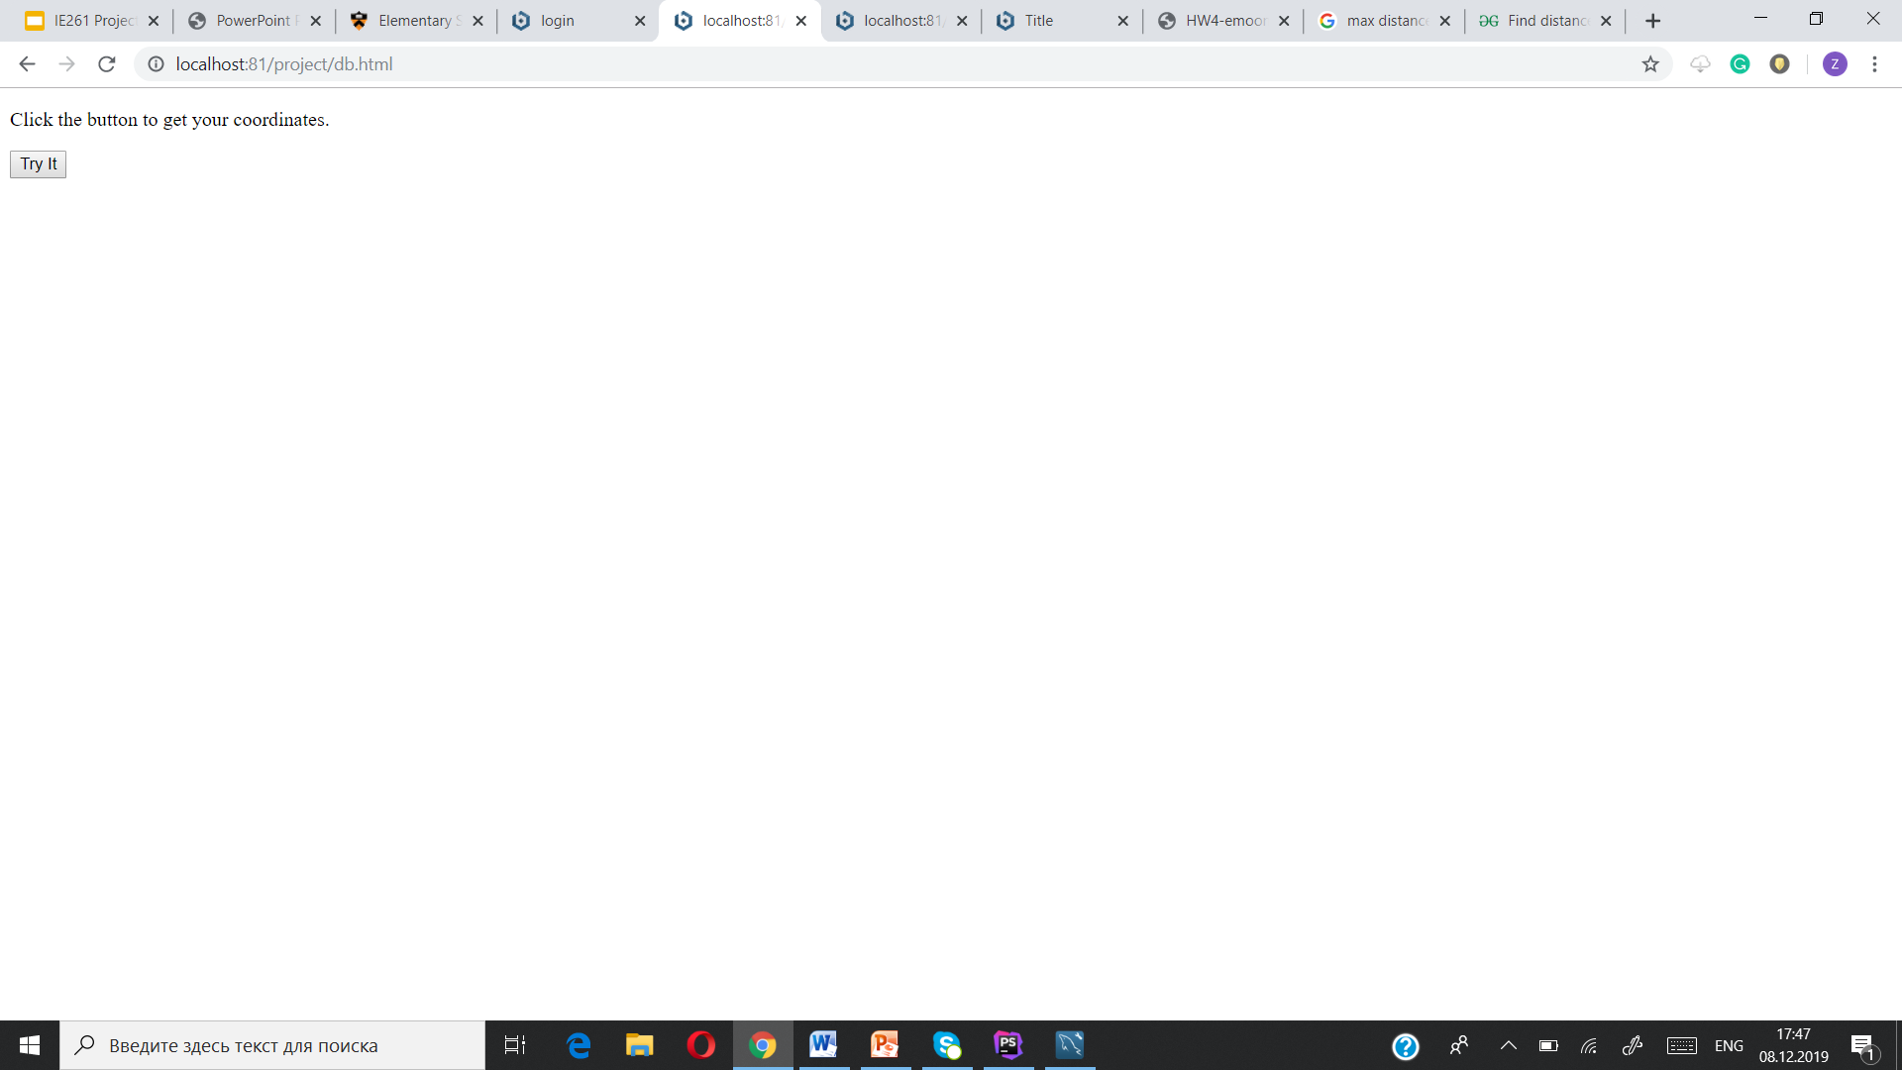

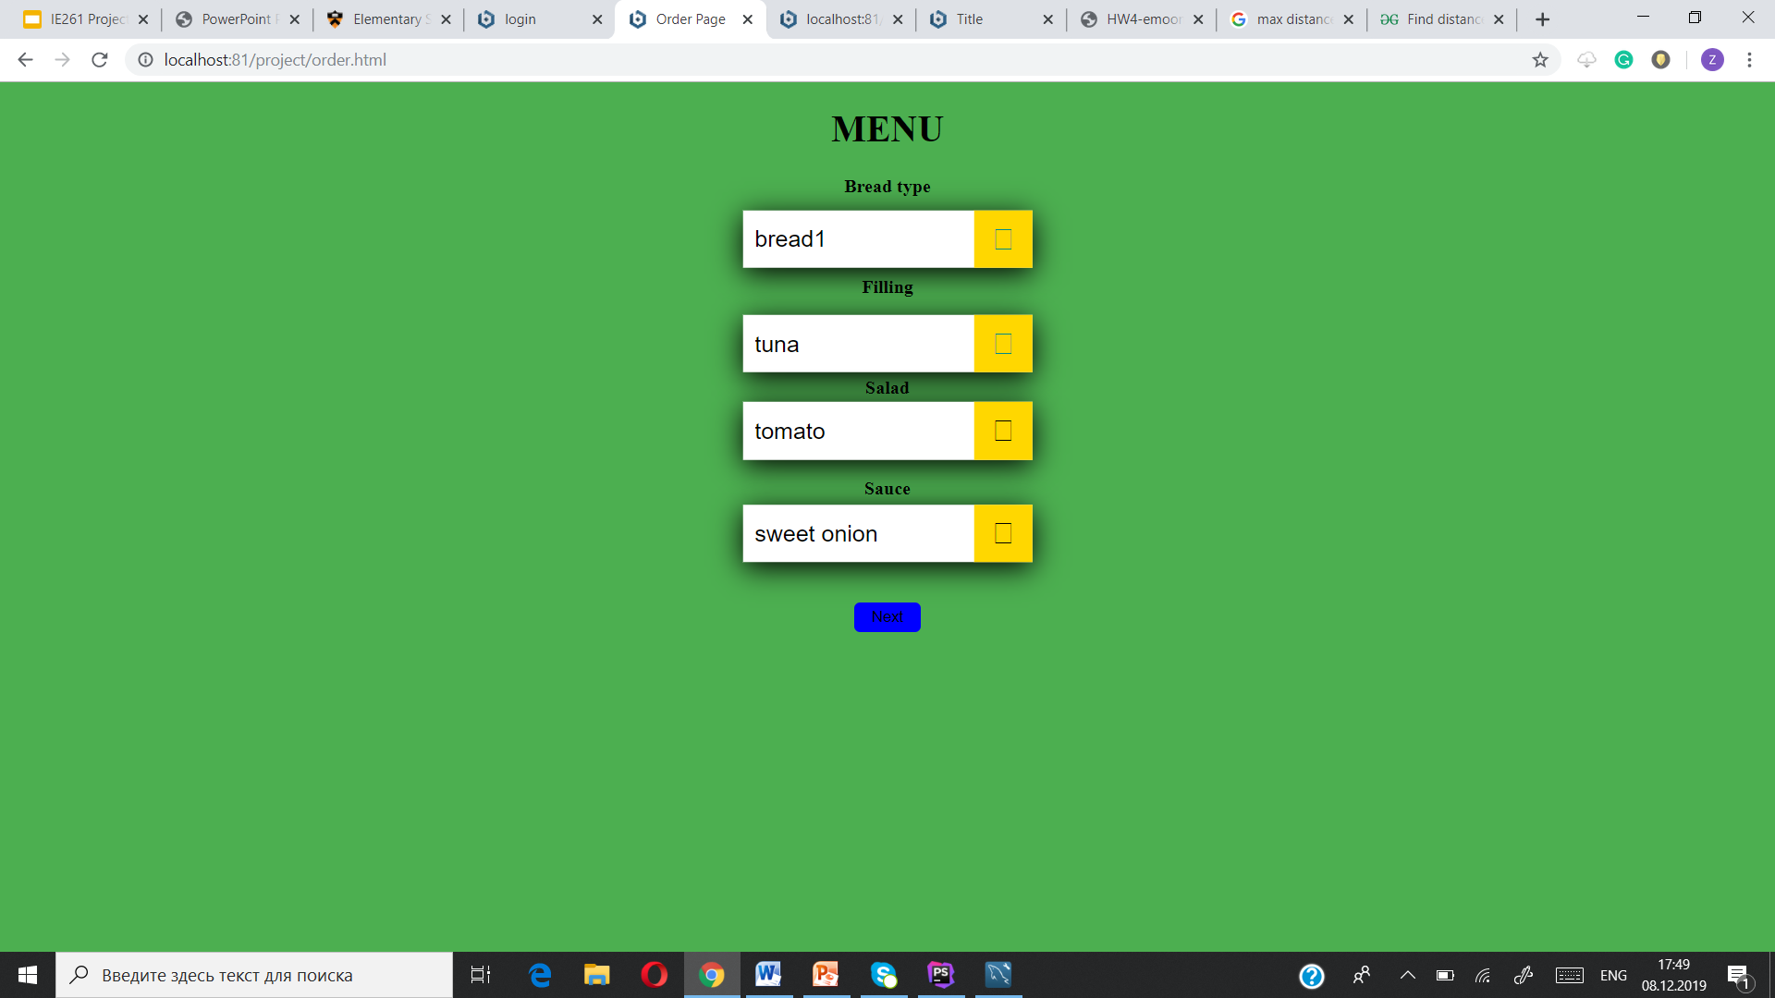
If you click find location(after “ready to make order”)
2)

Slide 36
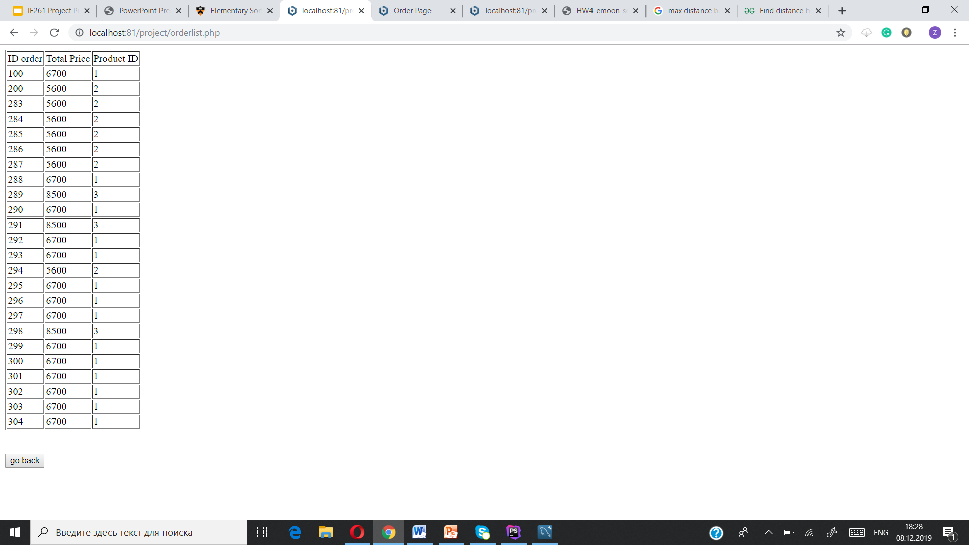
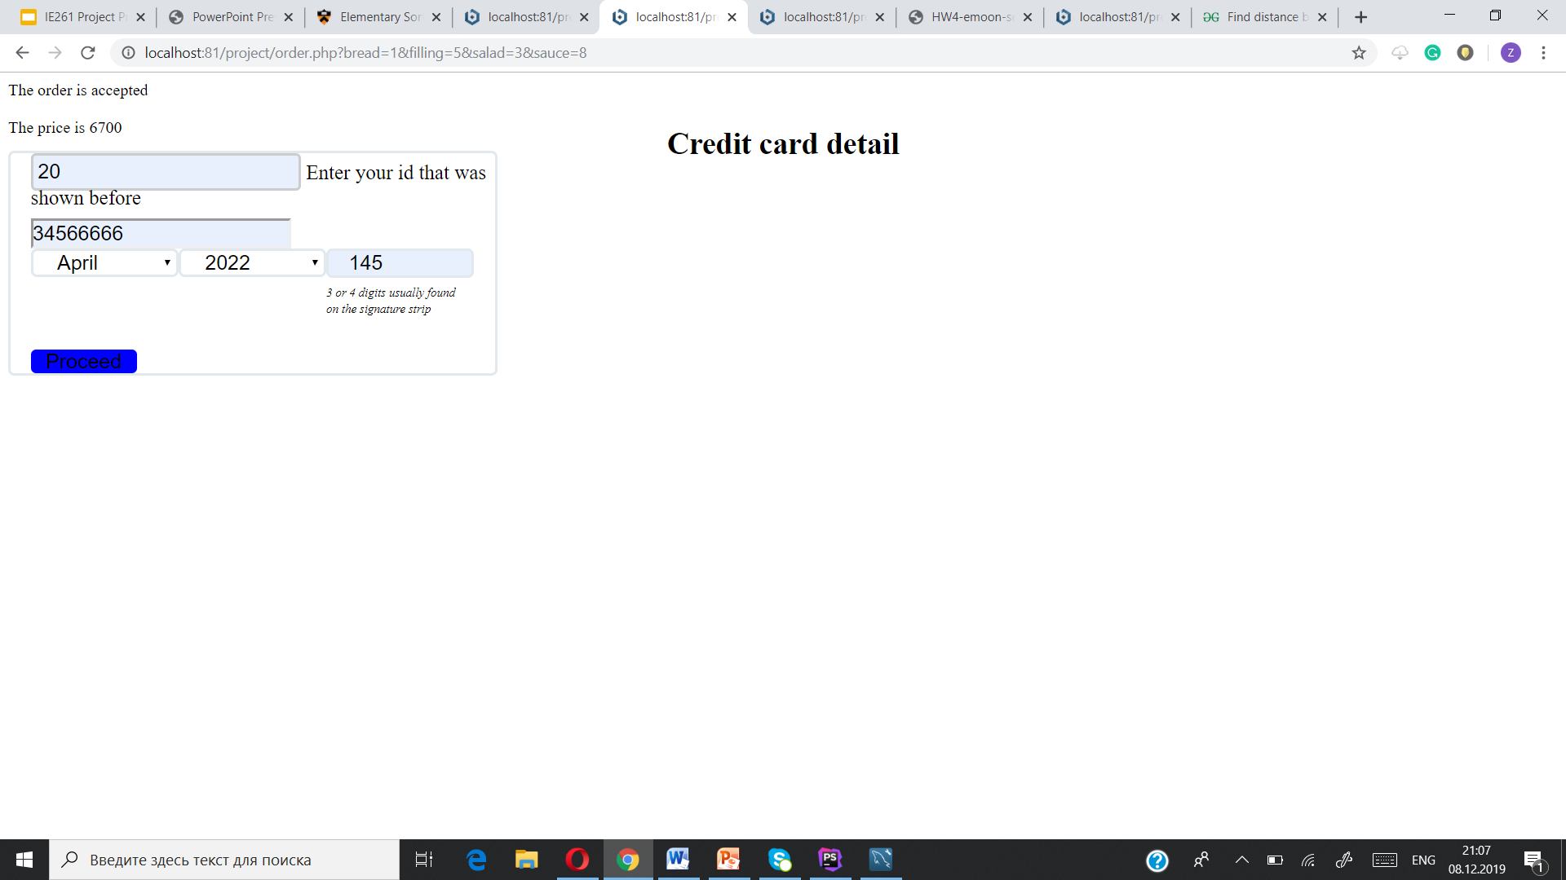
The order is accepted and added to table

Slide 37

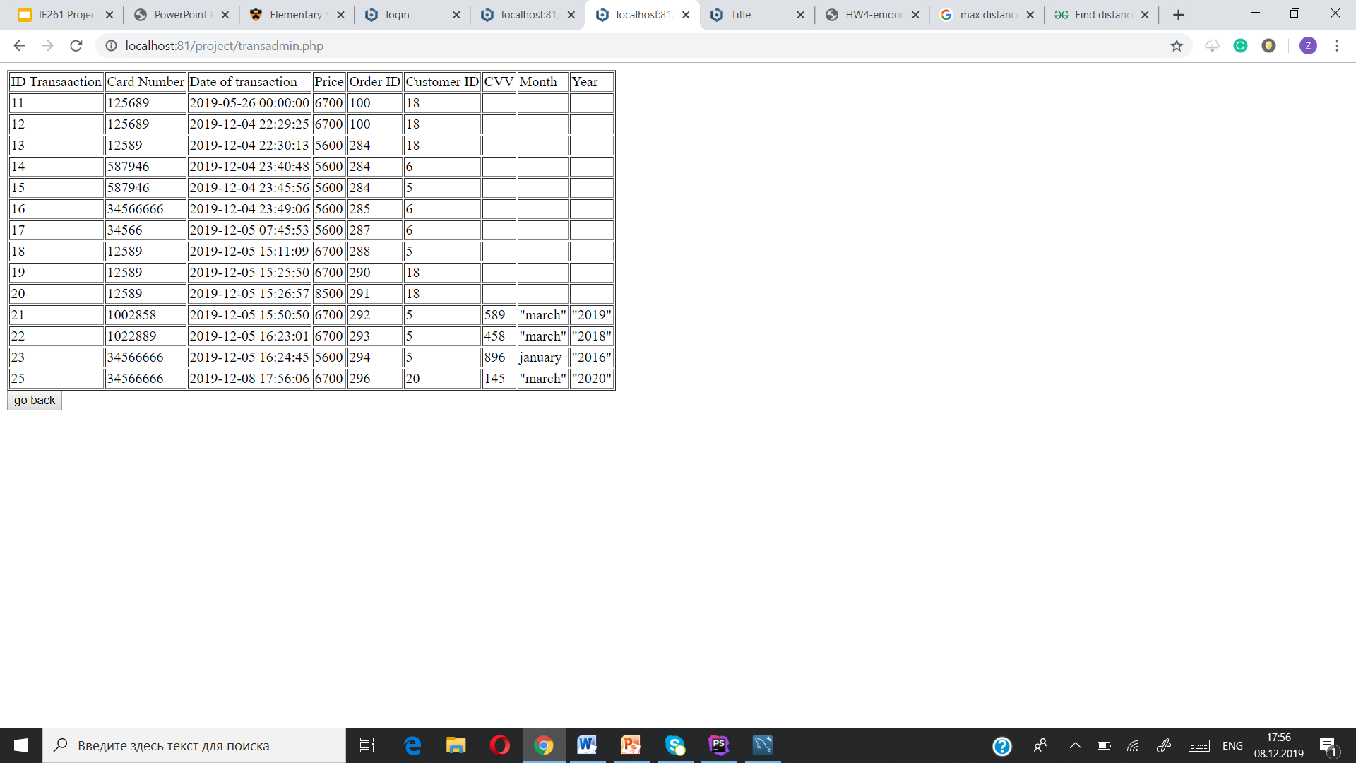
The transaction table information

Slide 38
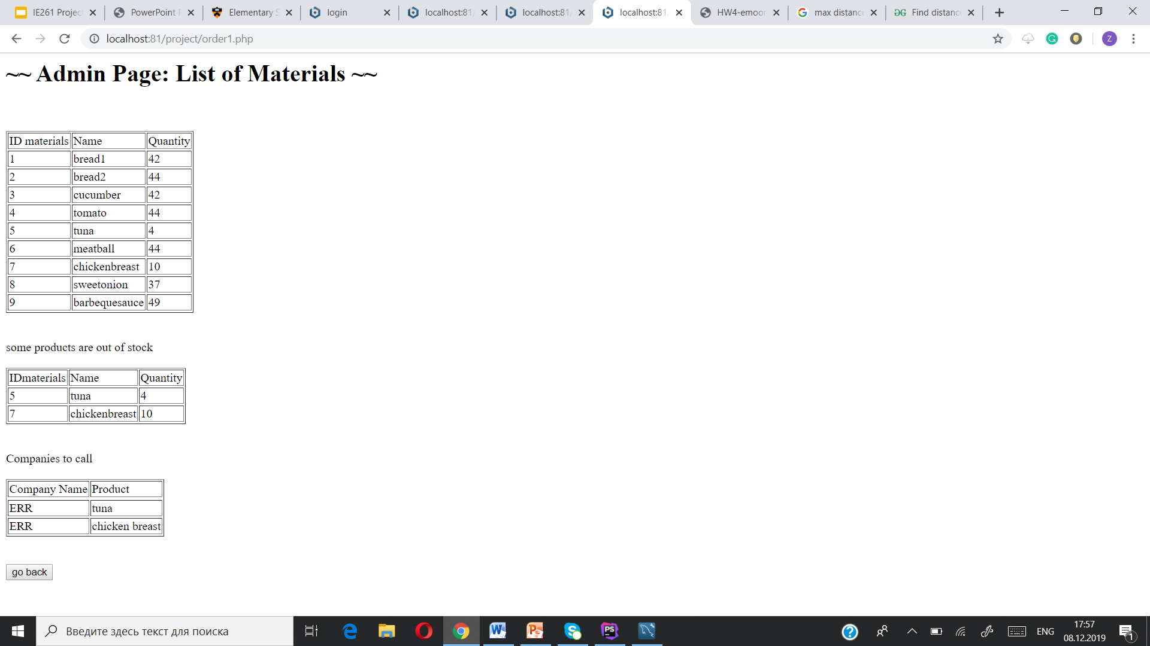

BEFORE AFTER(use of materials)

Slide 39
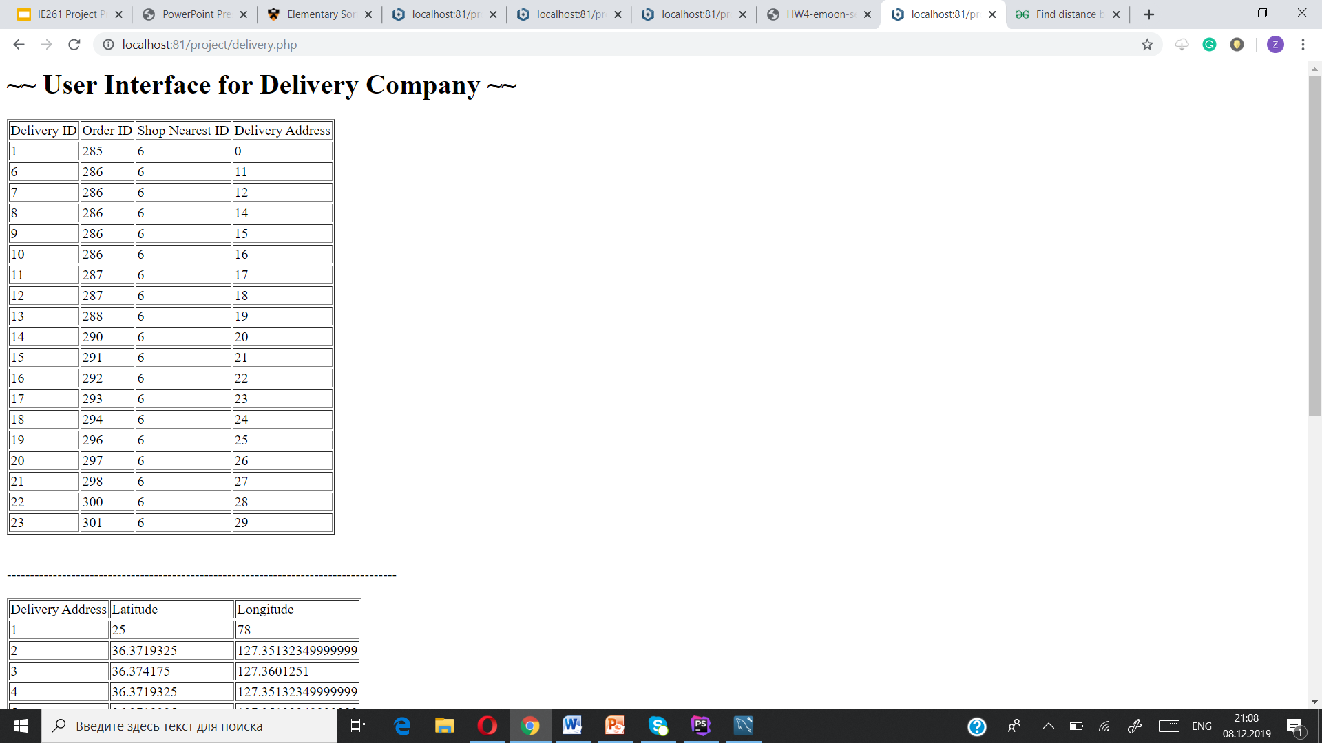
Delivery Company Interface

